Slide 1

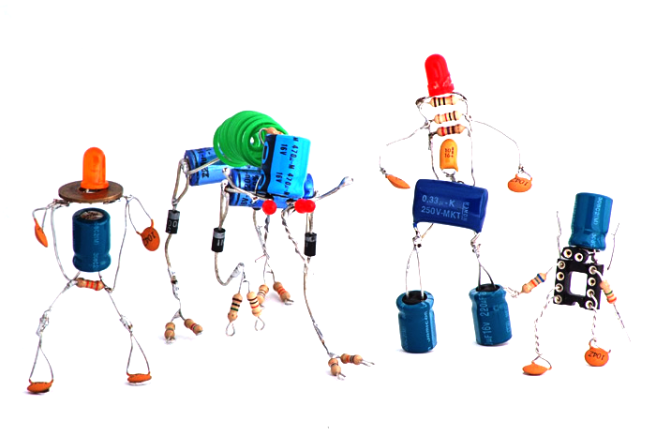

Basic hardware programming with Python & Raspberry PI

Slide 2
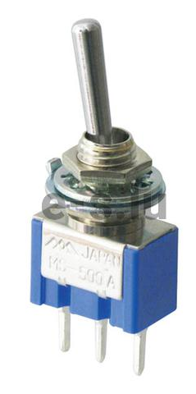
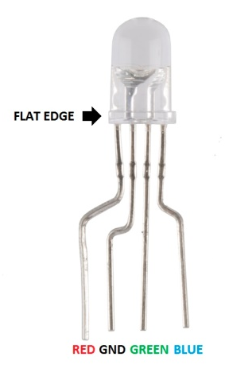
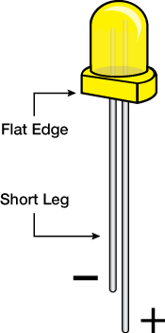
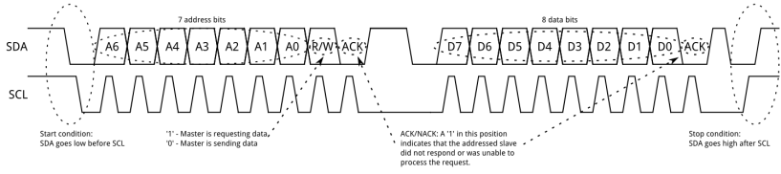
Types of hardware
Electricity based
GPIO (General Purpose Input/Output)
Electricity ON or OFF for input and output
Raspberry GPIO is v3.3 tolerant!
Communication based
I2C
SPI
One Wire
Serial

Slide 3
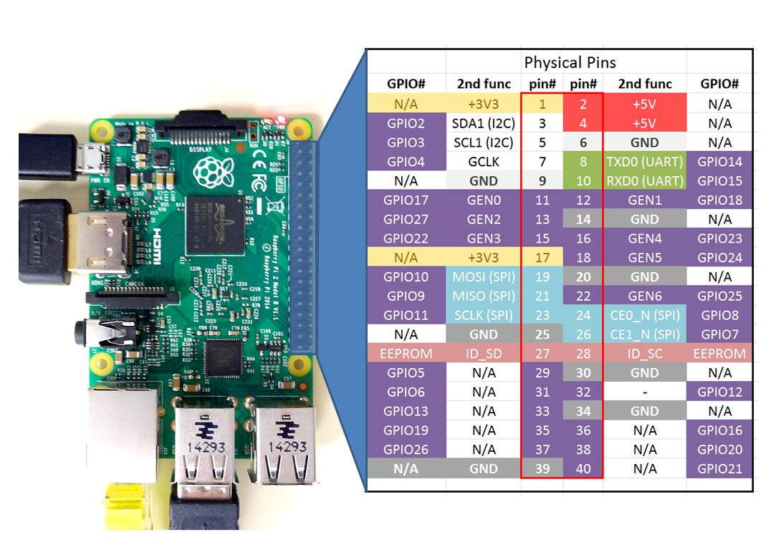
Raspberry PinOut

Slide 4
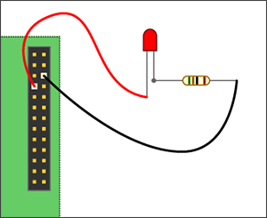
Switching - Output
#!/bin/python
# import the GPIO library
import RPi.GPIO as GPIO
ledPin = 4
# Set pinmode to Broadcom SOC.
GPIO.setmode(GPIO.BCM)
# Turn off warning messages.
GPIO.setwarnings(False)
# Set GPIO port to Output.
GPIO.setup(ledPin, GPIO.OUT)
# Turn on LED.
GPIO.output(ledPin, True)

Slide 5
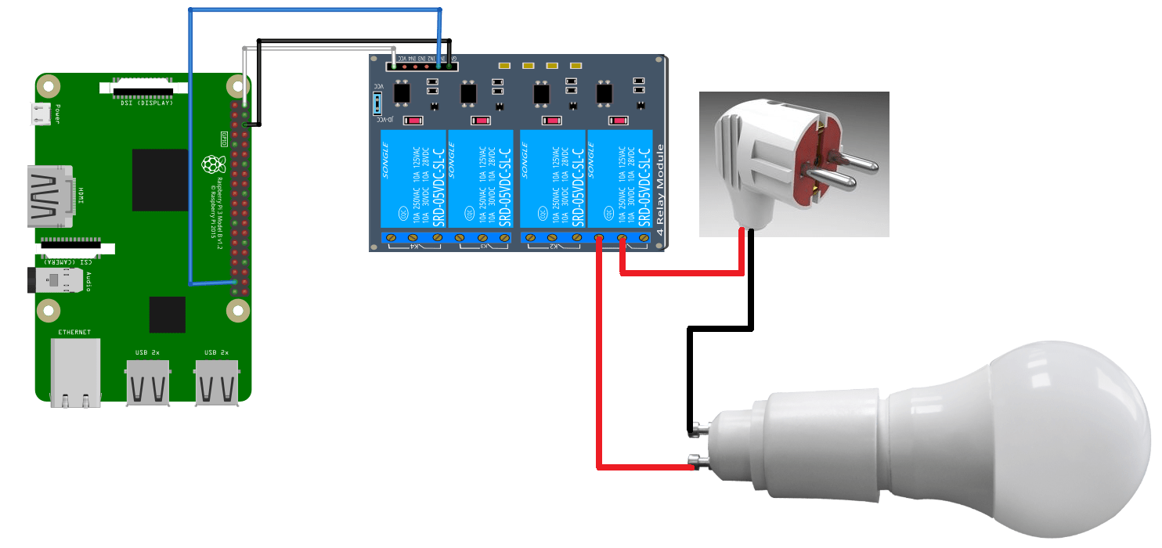
Switching – Output
Switching “Big Power” devices
Relay switch
Transistor
Mosfet (high power transistor)
Solid State

Slide 6
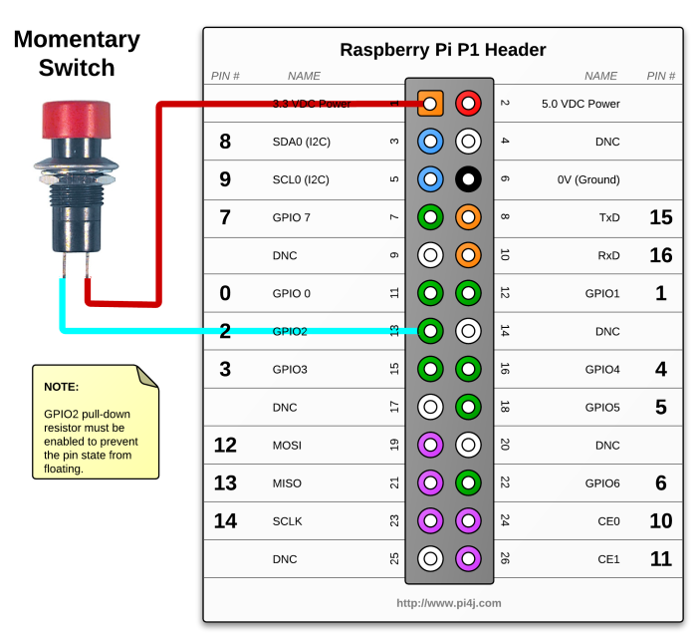
Switching – Input (Basic)
#!/bin/python
import RPi.GPIO as GPIO
from time import sleep
GPIO.setmode(GPIO.BCM)
GPIO.setwarnings(False)
GPIO.setup(5, GPIO.IN, pull_up_down = GPIO.PUD_DOWN)
while True:
print (GPIO.input(5))
time.sleep(1)

Slide 7

Switching – Input (Adv)
#!/bin/python
import RPi.GPIO as GPIO
from time import sleep
GPIO.setmode(GPIO.BCM)
GPIO.setwarnings(False)
print “press the button / switch"
# Execute this function when pressed.
def pressed(pin):
print (“button pressed on pin {}“.format(pin))
def loop():
try:
raw_input()
# Close when CTRL-C pressed
except KeyboardInterrupt:
GPIO.cleanup()
# Set GPIO as Input with using internal pulldown resistor
GPIO.setup(22, GPIO.IN, pull_up_down = GPIO.PUD_DOWN)
# Use interrupt for when button is pressed
GPIO.add_event_detect(22, GPIO.RISING, callback=pressed, bouncetime=200)
loop()

Slide 8
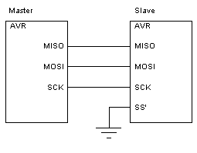
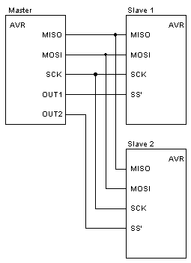
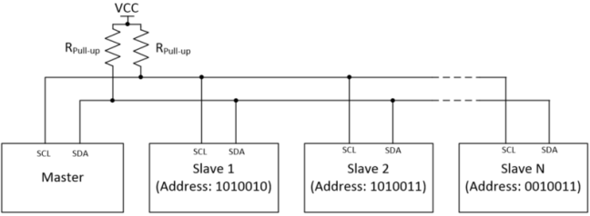
I2C vs SPI
SPI
Mainly single device (max 2)
I2C
Network of devices (127)

Slide 9
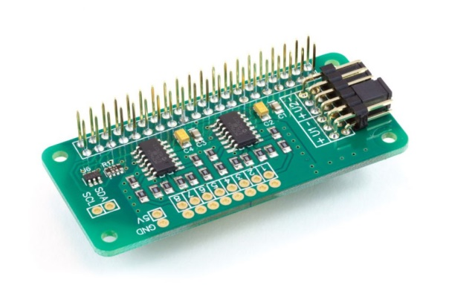
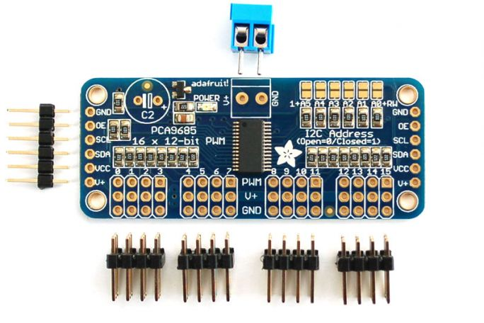
Analog and PWM
ADC Analog to Digital Converter
Microchip MCP3424 A/D based
8 x 17-bit 0 to 5V Single Ended Inputs
Control via the Raspberry Pi I2C port
input voltage range 0 – 5.06V
PWM
Pulse With Modulation
Mainly used for LED Dimming and Servo Control
PCA9685 – 16 Channel 12-bit PWM I2C Interface

Slide 10
Getting sensors / devices
Netherlands
https://www.kiwi-electronics.nl
https://www.sossolutions.nl/
UK
https://coolcomponents.co.uk/
https://www.modmypi.com/
US
https://www.adafruit.com/

